Slide 1




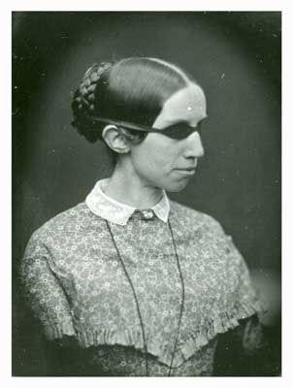
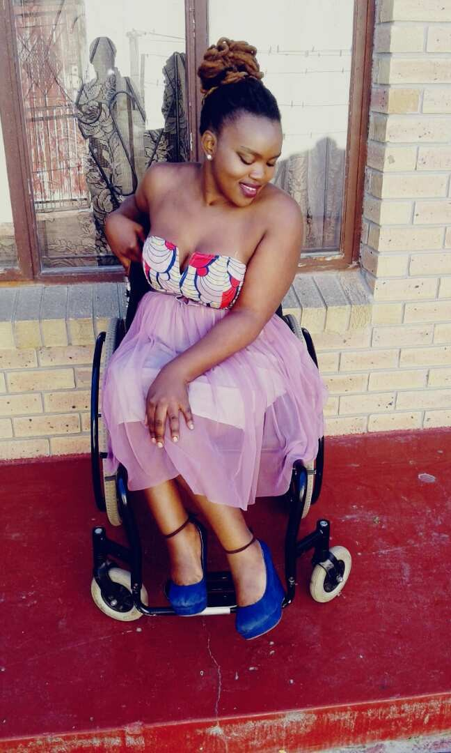


DISABILITY INCLUSION IN SEXUAL
AND REPRODUCTIVE HEALTH
Barr. Catherine Edeh, Executive Director
Voice of Disability Initiative (VDI)
Tel: +2348036866444 (WhatsApp Only)

Slide 2
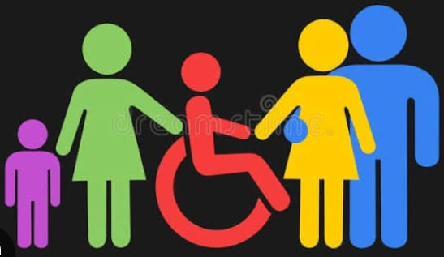
Presentation Outlines
Definitions of Disability
Understanding Disability
Disability Inclusion
Disability Inclusion in SRH
How to Ensure Disability Inclusion in SRH
Recommendations and Conclusion

Slide 3
WHO & UNCRPD Definitions
World Health Organization (WHO): “Disability is an umbrella term for impairments, activity limitations, and participation restrictions. It results from the interaction between individuals with a health condition and environmental or attitudinal barriers”
United Nations Convention on the Rights of Persons with Disabilities (UNCRPD): “Persons with disabilities include those who have long-term physical, mental, intellectual, or sensory impairments which, in interaction with various barriers, may hinder their full and effective participation in society on an equal basis with others.”

Slide 4
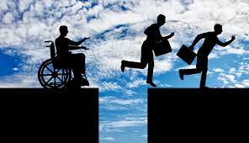
Understanding Disability
Disability results from the interaction between persons with impairments and attitudinal and environmental barriers that hinder their full and effective participation in society on an equal bases with others.
UNCRPD

Slide 5
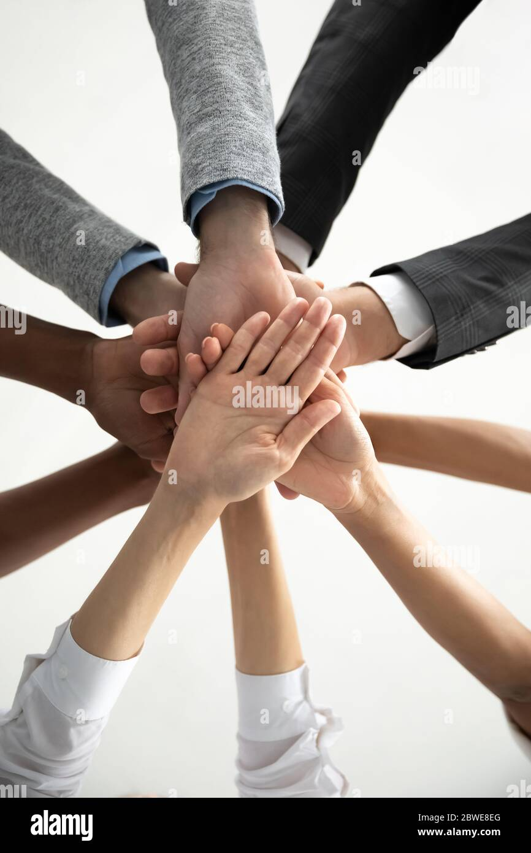
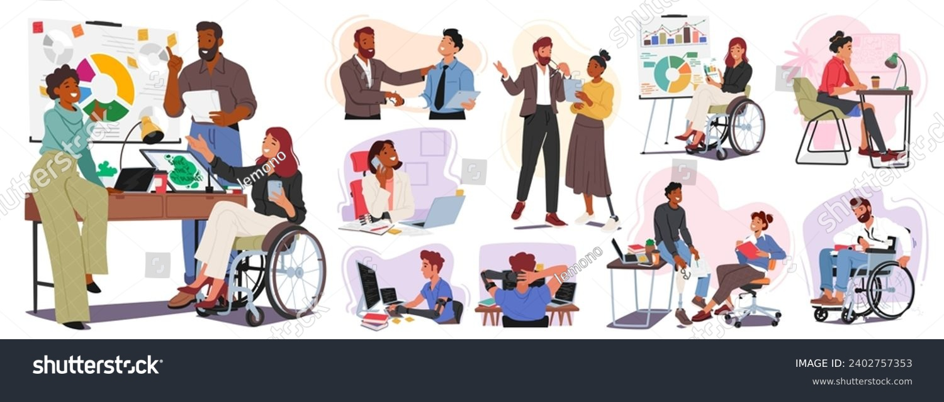
What is Disability Inclusion
Meaningful participation and integration of individuals with disabilities into all aspects of society

Slide 6
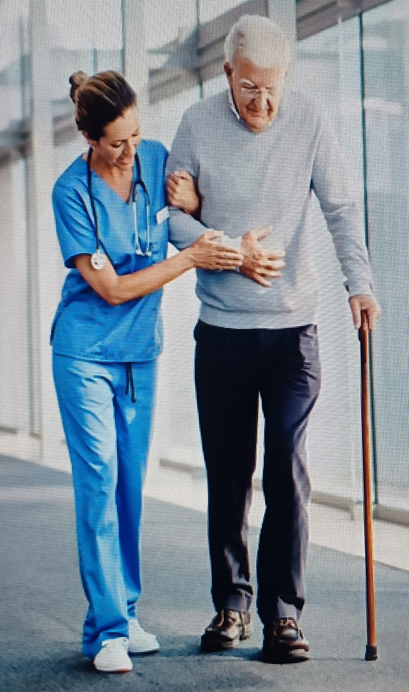

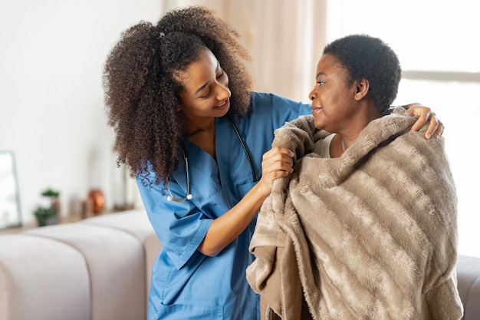
Disability Inclusion in SRH
Integration of disability-friendly programs into SRH services to ensure reasonable accommodation of all clusters of PWDs

Slide 7
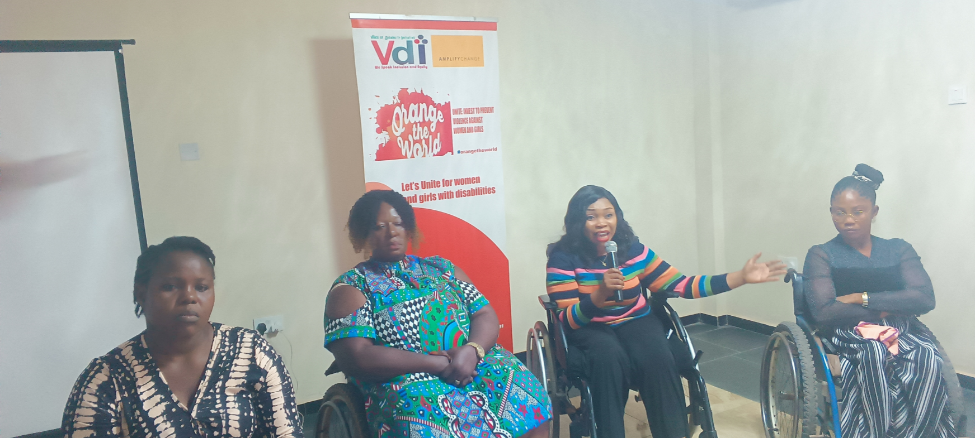
Experience of challenges in SRH clinics shared by Women With Disabilities (WWDs)
Notes:
Inaccessible infrastructure, lack of accessibility Aides, Language barriers, No ramps, lack of confidentitality, rejection, isolation, stigma, lack of disability support desks, etc. Ensuring disability inclusion and legal protections is essential to address these issues and create a more inclusive society for women with disabilities

Slide 8
Disability Inclusion in SRH:
Why it matters
SRH rights are human rights – Women and girls with disabilities must not be left behind.
Women and girls with disabilities (WGWD) have the right to access quality SRH services, yet they remain marginalized.
Nigeria’s Disability Law (2019): Prohibits discrimination on ground of disability status
The National Convention on the Rights of Persons withh Disabilities (NCRPWDs) prohibit Discrimination of any form against PWDs
Change is possible through policy, advocacy, and grassroots action.
Notes:
Inaccessible infrastructure, lack of accessibility Aides, lack of confidentitality, rejection, isolation, stigma, lack of disability support desks, etc. Ensuring disability inclusion and legal protections is essential to address these issues and create a more inclusive society for women with disabilities

Slide 9
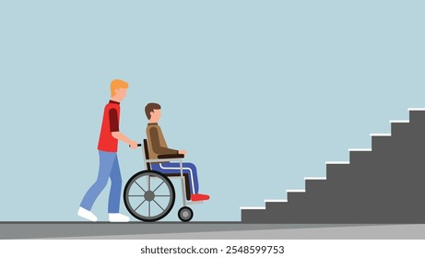
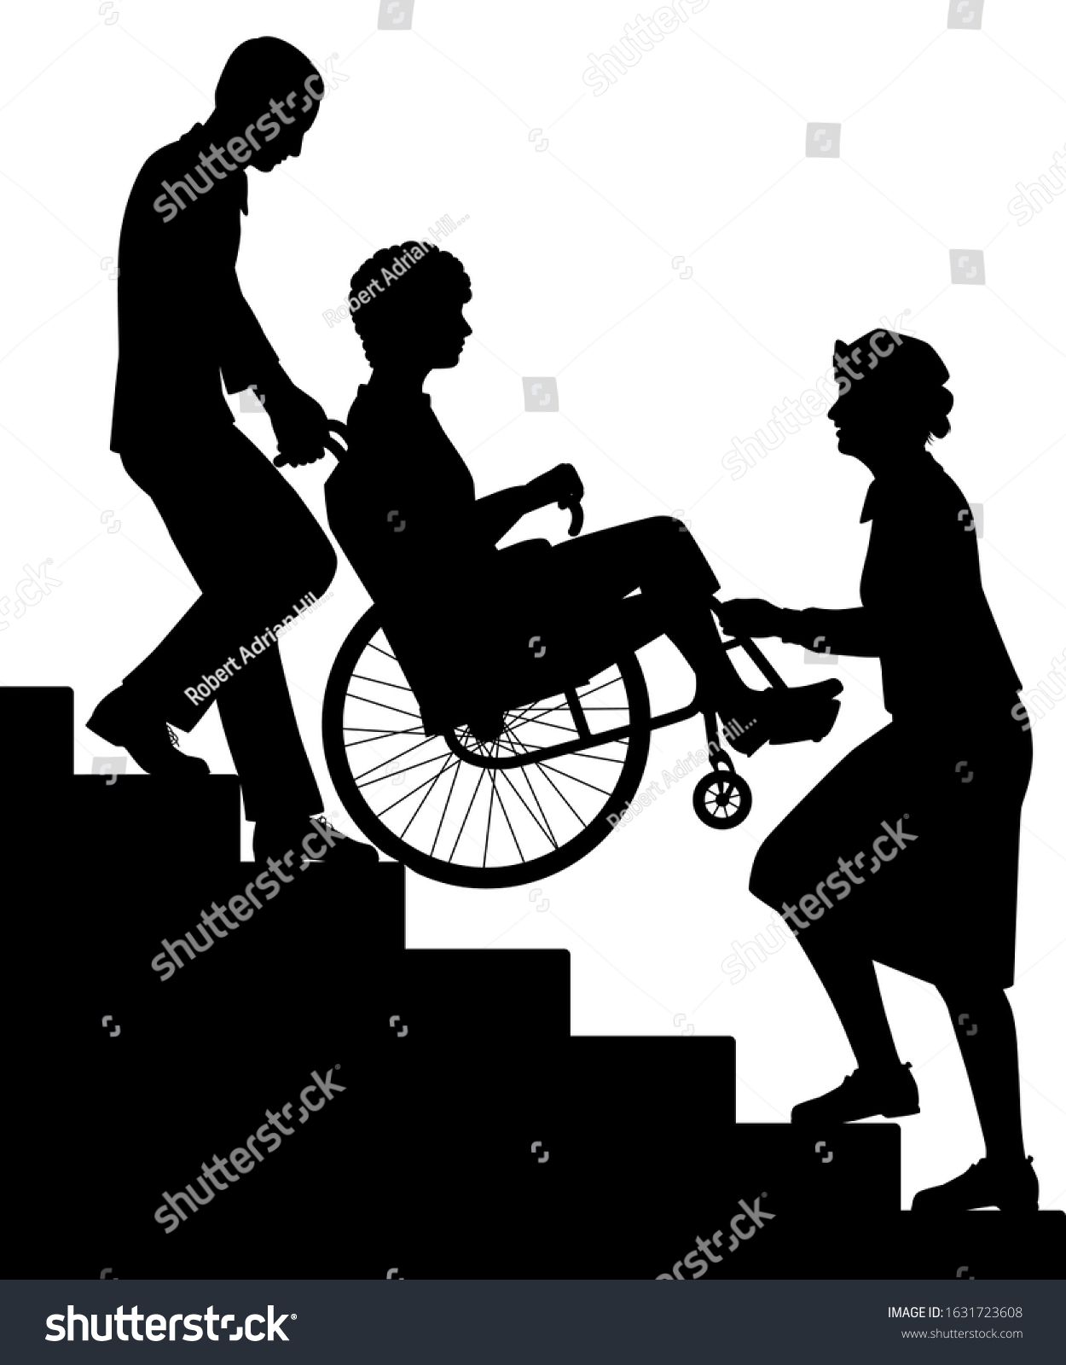
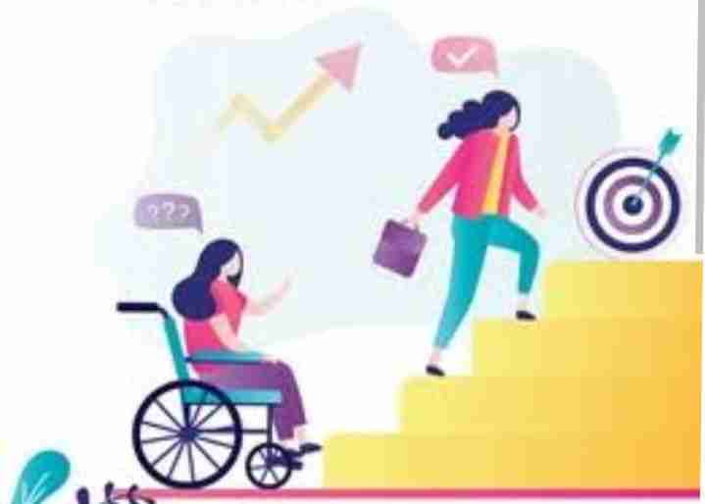

Examples of Physical Barriers
Notes:
Inaccessible infrastructure, lack of accessibility Aides, lack of confidentitality, rejection, isolation, stigma, lack of disability support desks, etc. Ensuring disability inclusion and legal protections is essential to address these issues and create a more inclusive society for women with disabilities

Slide 10
Recommendations for Disability inclusion in SRH
Dedicate funding for disability-friendly SRH services.
Making Disability Inclusion Training mandatory for all Healthcare provers.
Implement SRH outreach programs tailored to WGWD in rural areas.
Partners to prioritize Disability Inclusion in SRH in their health intervention Strategy
Enforce laws and policies that protect WGWD against discrimination in healthcare facilities.
Set up a Disability-Friendly Health Task Force in Healthcare facilities
Set up a Disability Support Desks in healthcare facilities
Notes:
Inaccessible infrastructure, lack of accessibility Aides, lack of confidentitality, rejection, isolation, stigma, lack of disability support desks, etc. Ensuring disability inclusion and legal protections is essential to address these issues and create a more inclusive society for women with disabilities

Slide 11
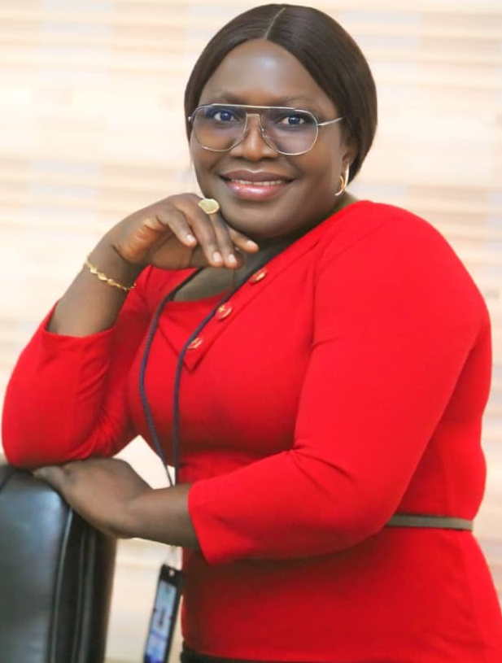
Conclusion/
Call to Action
Let’s make Nigeria a place where disability inclusion is the norm, and women of all abilities can thrive and contribute to our nation’s growth and prosperity. Together, we can turn this vision into a reality.
Notes:
Inaccessible infrastructure, lack of accessibility Aides, lack of confidentitality, rejection, isolation, stigma, lack of disability support desks, etc. Ensuring disability inclusion and legal protections is essential to address these issues and create a more inclusive society for women with disabilities

